Slide 1
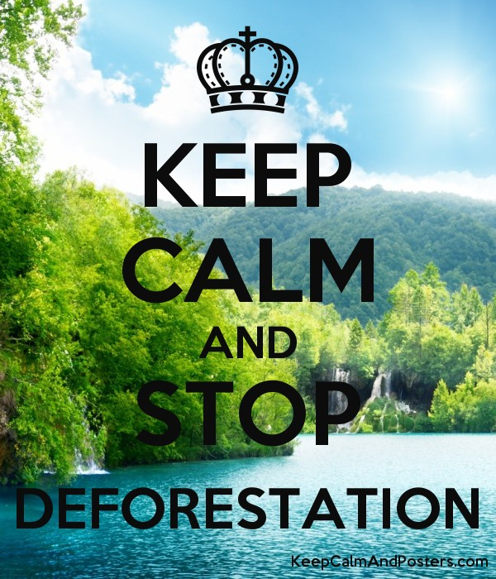
THE TREE REVOLUTION
VISIBLE EFFECTS OF DEFORESTATION
EXTINCTION OF ANIMALS AND PLANT SPECIES
GLOBAL WARMING
EXPANSION OF DESERTS
HUMAN AND ANIMAL CONFLICTS
DRYING UP OF WATER BODIES
CHANGE IN CLIMATIC PATTERNS
DROUGHTS AND FAMINE
INCREASE IN MORTALITY RATES
IMPORTANCE OF TREES
PROVIDING OXYGEN
IMPROVING AIR QUALITY
CONSERVING WATER
PRESERVING SOIL
IMPROVING OF CLIMATE

Slide 2
HOW TREES SUSTAIN US!
Trees create a balance in the earth because they nourish everything with oxygen. Additionally, they absorb carbon dioxide gas hence reduce the green gas effect. At this rate of deforestation, trees are predicted to be extinct in the next 500 years lest action is taken to save the remaining trees and plant more. Critics argue that trees are a raw material to complement human life, but it won't be beneficial if we all die after we exhaust all the trees. Moreover, trees attract rainfall; lack of trees on the planet will then lead to catastrophes like droughts that are accompanied by famine. As large green corporations foretaste the Amazon forest, all of us can double the effort by preserving our homegrown trees and planting more. Remember, if trees die, we all die.

Slide 3
References
Gourdji, Sharon, et al. "Historical climate trends, deforestation, and maize and bean yields in Nicaragua." Agricultural and Forest Meteorology 200 (2015): 270-281.
Lawrence, Deborah, and Karen Vandecar. "Effects of tropical deforestation on climate and agriculture." Nature Climate Change 5.1 (2015): 27.
Zemp, D. C., et al. "Deforestation effects on Amazon forest resilience.“ Geophysical Research Letters 44.12 (2017): 6182-6190

